Slide 1

Vehicle Fuel Economy Presentation
By Tim Scherman

Slide 2
background
Looking to offer suggestions on car makes and models based on varying specifications
Evaluated fuel economy by City, Highway, and Combined MPG averages by make as well as annual fuel costs and an overall 5 year save or spend estimate
Also paying attention to averages in MPG between cars that take Regular, Premium, or Diesel fuels
Will conduct several t-tests on Regular vs Premium gas mileage as well as the difference between city and highway MPG in Diesel cars

Slide 3
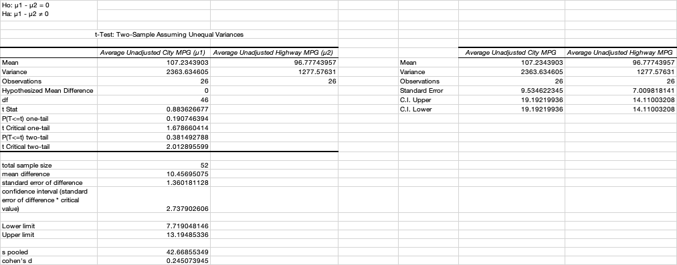
Electric car City mpg vs highway mpg t-tests
Test did not reveal there is a significant difference in the MPG between the city and highway for electric cars
Test could be a little bias because of small cohen’s d and sample size

Slide 4
Regular vs premium Avg city mpg t-tests
Ho: μ1 - μ2 = 0 Ha: μ1 - μ2 ≠ 0
t-Test: Two-Sample Assuming Unequal Variances
 | Average City MPG (μ1) | Average City MPG (μ2) |  |  | Average City MPG (μ1) | Average City MPG (μ2)
Mean | 17.13588279 | 16.55661695 |  | Mean | 17.13588279 | 16.55661695
Variance | 13.47604819 | 15.89321235 |  | Variance | 13.47604819 | 15.89321235
Observations | 47 | 37 |  | Observations | 47 | 37
Hypothesized Mean Difference | 0 |  |  | Standard Error | 0.535466553 | 0.655397803
df | 74 |  |  | C.I. Upper | 1.066940397 | 1.305908628
t Stat | 0.684446218 |  |  | C.I. Lower | 1.066940397 | 1.305908628
P(T<=t) one-tail | 0.247915755
t Critical one-tail | 1.665706893
P(T<=t) two-tail | 0.495831511
t Critical two-tail | 1.992543495
total sample size | 84
mean difference | 0.579265847
standard error of difference | 0.817009991
confidence interval (standard error of difference * critical value) | 1.627927944
Lower limit | -1.048662097
Upper limit | 2.207193791
s pooled | 3.83205301
cohen's d | 0.151163318
Test revealed no significant difference in gas mileage between the two fuels
We cannot fully make this conclusion because of lack of sample size

Slide 5
Regular vs premium Avg highway mpg t-tests
Ho: μ1 - μ2 = 0 Ha: μ1 - μ2 ≠ 0
t-Test: Two-Sample Assuming Unequal Variances
 | Average Highway MPG (μ1) | Average Highway MPG (μ2) |  |  | Average Highway MPG (μ1) | Average Highway MPG (μ2)
Mean | 22.49962272 | 23.05198694 |  | Mean | 22.49962272 | 23.05198694
Variance | 25.99199234 | 24.37285576 |  | Variance | 25.99199234 | 24.37285576
Observations | 47 | 37 |  | Observations | 47 | 37
Hypothesized Mean Difference | 0 |  |  | Standard Error | 0.743653894 | 0.811619265
df | 79 |  |  | C.I. Upper | 1.480206049 | 1.615487737
t Stat | -0.501787196 |  |  | C.I. Lower | 1.480206049 | 1.615487737
P(T<=t) one-tail | 0.30860642
t Critical one-tail | 1.664371409
P(T<=t) two-tail | 0.617212841
t Critical two-tail | 1.99045021
total sample size | 84
mean difference | 0.552364224
standard error of difference | 0.916259539
confidence interval (standard error of difference * critical value)
 | 1.823768992
Lower limit | -1.271404768
Upper limit | 2.376133216
s pooled | 5.018209247
cohen's d | 0.110071979
Test revealed no significant difference in gas mileage between the two fuels
We cannot fully make this conclusion because of lack of sample size

Slide 6
Diesel Car city vs highway mpg t-tests
t-Test: Two-Sample Assuming Unequal Variances |  | Ho: μ1 - μ2 = 0 Ha: μ1 - μ2 ≠ 0
 | Average City MPG | Average Highway MPG |  |  | Average City MPG | Average Highway MPG
Mean | 22.9601873 | 28.33029005 |  | Mean | 22.9601873 | 28.33029005
Variance | 30.46666902 | 44.42448807 |  | Variance | 30.46666902 | 44.42448807
Observations | 13 | 13 |  | Observations | 13 | 13
Hypothesized Mean Difference | 0 |  |  | Standard Error | 1.530878808 | 1.84858549
df | 23 |  |  | C.I. Upper | 3.166864097 | 3.824090442
t Stat | -2.237376134 |  |  | C.I. Lower | 3.166864097 | 3.824090442
P(T<=t) one-tail | 0.017621228
t Critical one-tail | 1.713871528
P(T<=t) two-tail | 0.035242457
t Critical two-tail | 2.06865761
total sample size | 26
mean difference | 5.370102748
standard error of difference | 0.828135251
confidence interval (standard error of difference * critical value)
 | 1.713128289
Lower limit | 3.65697446
Upper limit | 7.083231037
s pooled | 6.11927925
cohen's d | 0.877571121
We reject the null that there is no difference in means. The difference is significant at the 0.035 level. We are 95% confident that the average difference in miles per gallon in diesel engines for city MPG and highway MPG is between 3.65 and 7.08

Slide 7
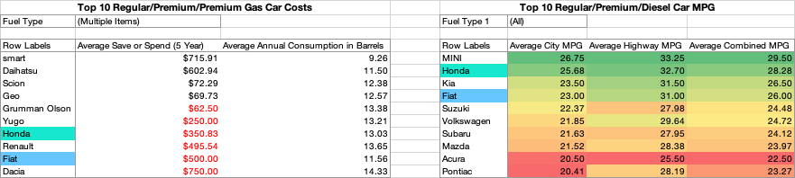
Best gas car recommendations

Slide 8
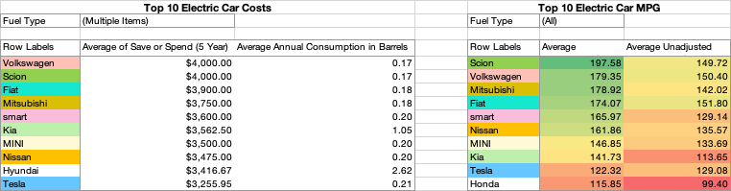
Best Electric car recommendations

